Slide 1
Solar Energy
Oak Park High School
Idea To Impact
2014
Alexis Cheney Dorinda Fong Kristen Bender Rachel Convey Laura Cruz-Albrecht Wendy Xiao

Slide 2
Forms of Energy
Which types of energy does the sun give us?
A quick review…
Thermal (heat)
Electromagnetic (light)
Chemical (body functions)
Other forms of energy include:
Electrical
Electrochemical
Sound
Potential
Kinetic
Notes:
Kristen

Slide 3
What Is Renewable Solar Energy?
Solar energy-energy from the sun
Comes in the form of thermal (heat)
and electromagnetic (light) energy
Obtainable directly from the sun or indirectly from moving water, wind, and biomass

Slide 4
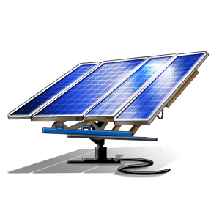
Solar Energy
Types and Uses
Types
Photovoltaic (PV)
Crystalline
Thin Film
BIPV Roof Shingles
Active
Closed Loop
Open Loop
Passive
ICS
Thermosyphon
Concentrated
Solar Cookers
Mirror Utilities Systems
Uses
Commercial, industrial or residential
Transportation: cars, boats, planes
Satellites ←
Cool projects!
Notes:
Kristen

Slide 5
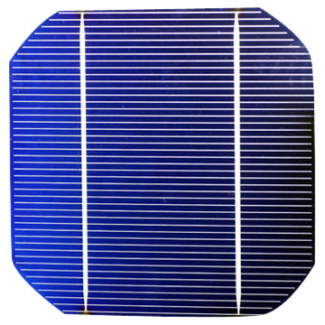
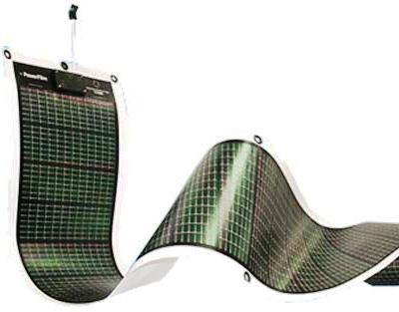
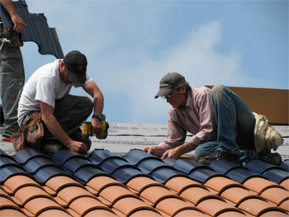
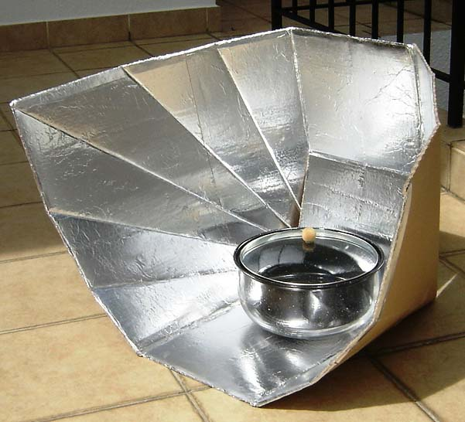
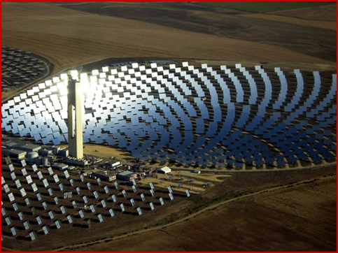
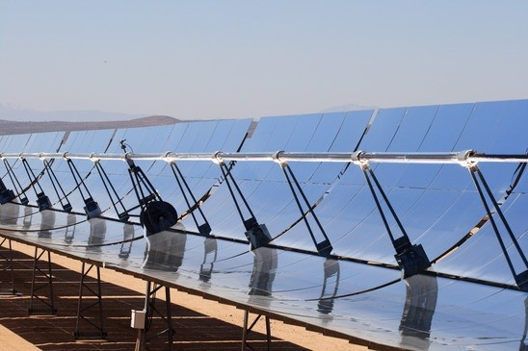
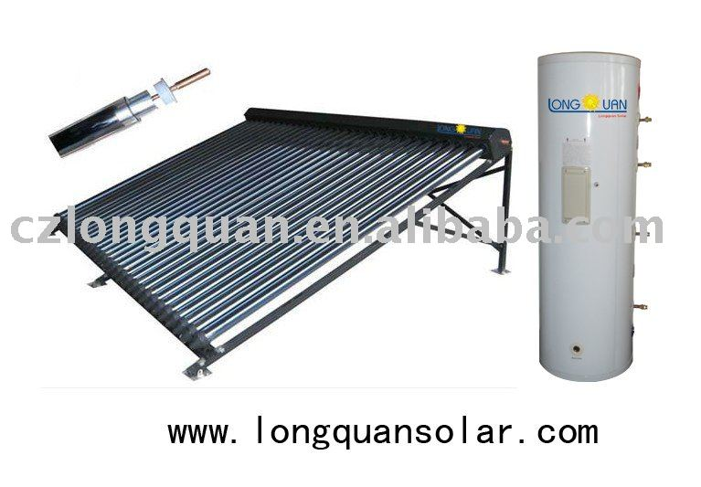
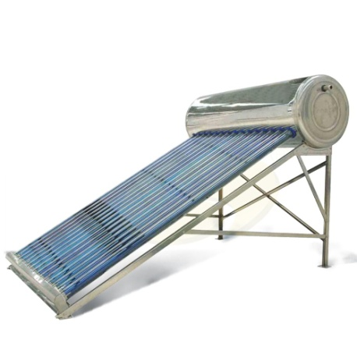
Solar Energy
Crystalline
Thin Film
BIPV
Solar Cookers
Heliostats and Parabolic Trough Systems
Closed Loop
Thermosyphon

Slide 6
Solar Heating
Heating Water

Slide 7
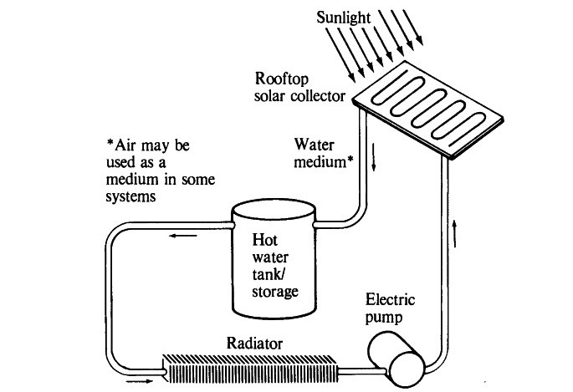
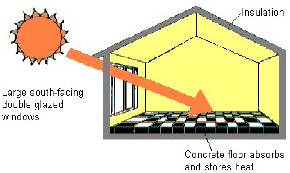
Solar Heating
Passive and Active
Active solar heating system: absorbs energy from sun by pumping heat-absorbing fluid (water or anti-freeze) through special collectors
Can be used to heat water
Passive solar heating system: absorbs and stores heat directly from sun without pumps or fans
Ex: concrete, adobe, brick, stone store solar energy as heat then release it slowly during the day and night

Slide 8
Solar Heating
Advantages & Disadvantages
Pros
Cons
Free energy
No CO₂ emissions
Quick installation
Net energy
Average active
High passive
Moderate cost
Requires sun more than half the time
Need heat storage system
Maintenance & repair
Unattractive asthetics

Slide 9
Solar Thermal Energy
Central Receiver Systems: Power Tower & Heliostats

Slide 10
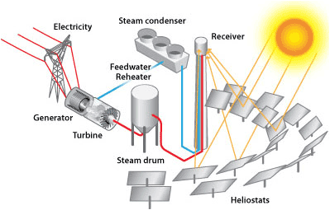
Solar Thermal Energy
Central Receiver Systems: Power Tower & Heliostats
Heliostats (mirrors or reflectors) direct sunlight to receiver on collector tower
Heat transfer fluid is pumped up the tower and heated by focused solar energy
High pressure steam turns turbine, generating electricity

Slide 11
Solar Thermal Energy
Solar Thermal Plant/Parabolic Trough

Slide 12
Solar Thermal Energy
Note the difference between heliostats & parabolic troughs
Solar Thermal Plant/Parabolic Trough
Sunlight hits the receiver (parabolic mirrors or reflectors)
Receivers direct the sunlight to receiver tube, which is filled with heat transfer fluid and is located at focal line of parabola
Hot fluid transfers heat to water in heat exchanger
The steam powers the turbine, generating electricity

Slide 13
Solar Thermal Energy
Advantages & Disadvantages
pros
cons
No CO₂ emissions
Quick construction
Moderate environmental impact and net energy
Reduced costs of turbine back-up
Low efficiency
High cost
Needs back-up system
Requires large land plots
May impact desert environment

Slide 14
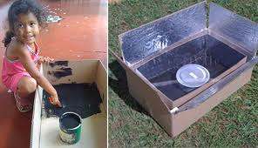
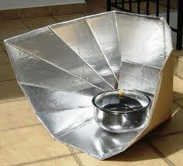
Solar Thermal Energy
Solar Cooking!
Utilizes thermal energy
Solar cookers can reach 250°F to 425°F
Anything that is normally cooked in an oven can be put in a solar cooker
Becoming popular and useful around the world
Cook meals
Sanitize medical devices
Clean and heat water
No electricity required
No pollution
You can build a solar cooker!

Slide 15
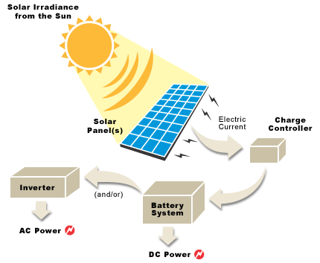
Solar Panels
Photovoltaic Cell-semiconductor material generates voltage and current
Module-cells wired together
Array-One or more modules with hardware
Charge Controller-equipment regulates battery voltage
Battery Storage-stores DC electrical energy
Inverter-converts DC to AC to operate loads that require AC
DC Loads-appliances, motors and equipment powered by direct current
AC Loads-appliances, motors and equipment powered by alternating current
Parts of a PV System

Slide 16
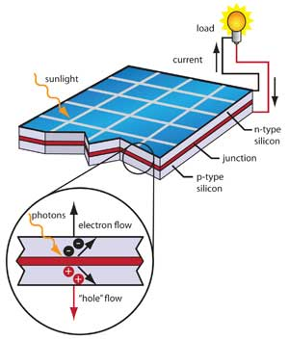
Solar Panels
Photovoltaic (PV) Solar System Focus
PV systems transform the energy of light particles (photons) from the sun into electricity.
PV cells are made of silicon wafers which absorb the photons that hit it
Cells are connected to make modules and arrays
It can collect energy and store it as electricity for later
Energy cannot be created or destroyed but it can be changed into different forms.
Notes:
Kristen

Slide 17
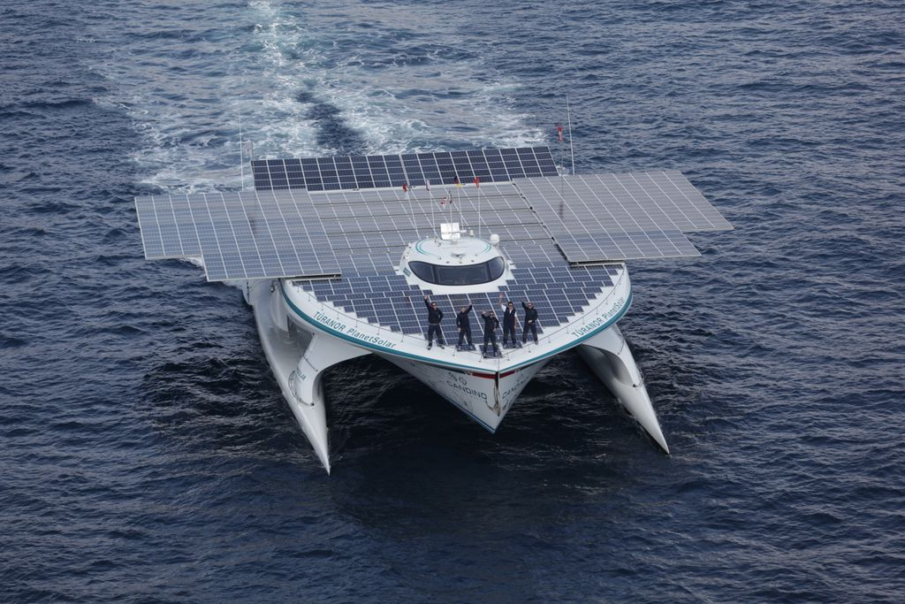
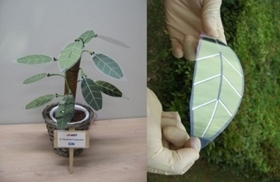
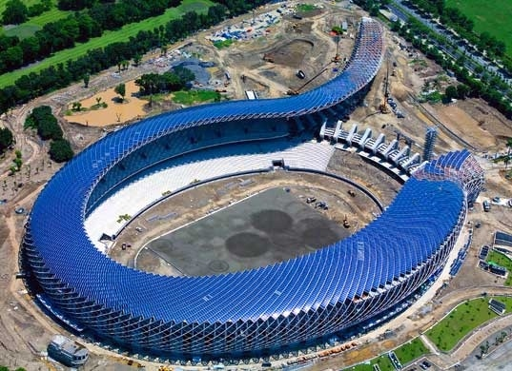
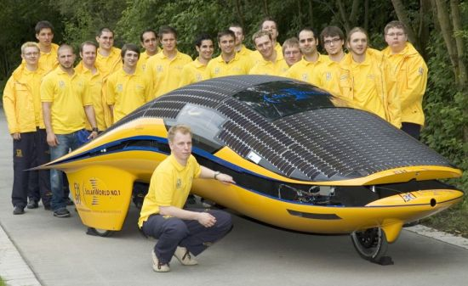
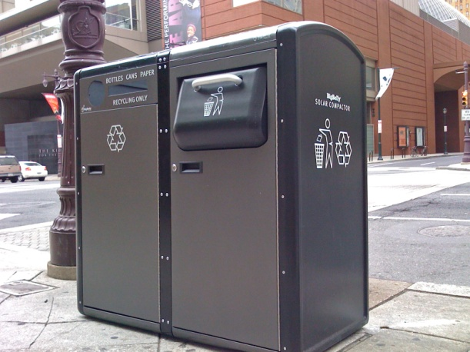
Solar Panels
Technological Advances
Increase efficiency-silicon
Lower production costs
Nanoparticles/Nano flakes
Organic solar cells
Solar films not from silicon
Liquid solar array
Notes:
Kristen

Slide 18
Solar Panels
Advantages & Disadvantages
pros
cons
No CO₂ emissions
High net energy
Quick installation
Easy to move or expand
Work in inclement weather
Small environmental impact
Last several decades
Low efficiency levels
Need back-up
Solar cell power plants take up large land plots
Expensive
DC convert to AC

Slide 19
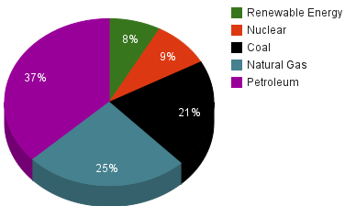
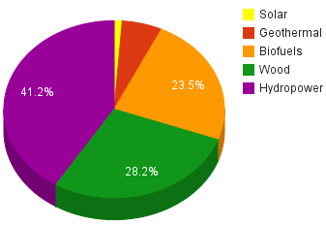
Energy Usage in the United States
Only 8% is renewable!
Notes:
Kristen

Slide 20
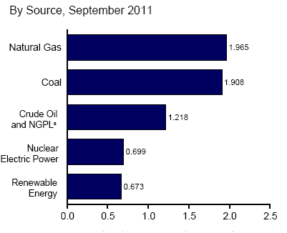
Energy Usage in the United States
More recent data
Used the most:
Natural Gas
Used the least: Renewable energy
…which includes solar energy!
Notes:
Kristen

Slide 21
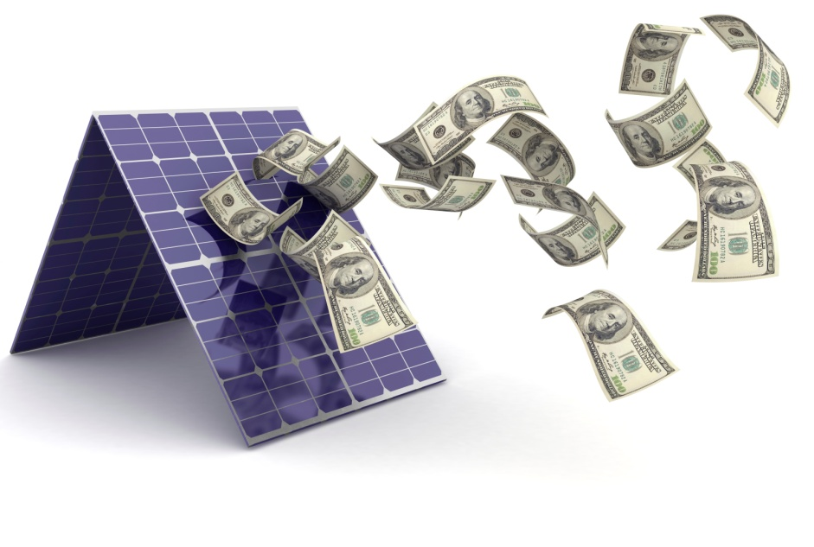
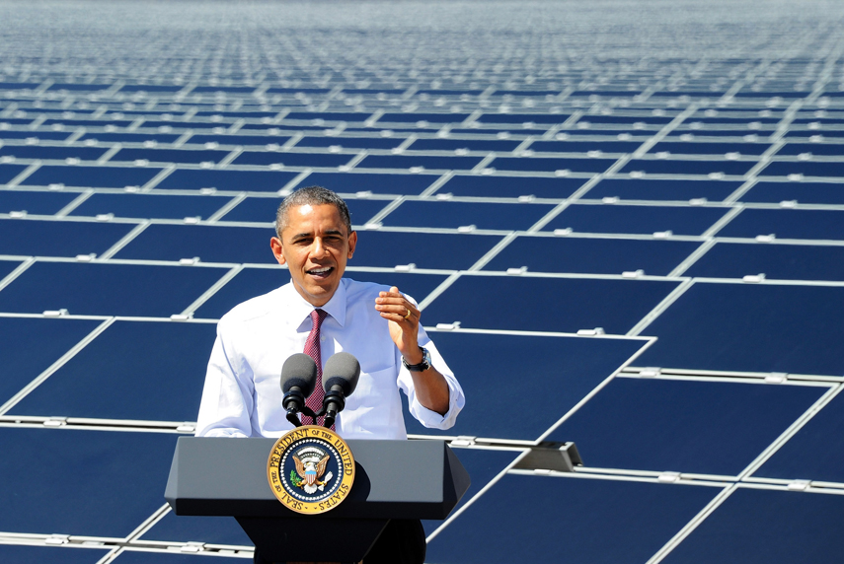
Why is solar limited?
People & Government
Consumers: expensive pricing deters buyers from long term benefits
Economic perspective: unequal subsidies, overpricing
Government: slowly willing to support in recent years, focus on broad concepts of “clean energy” and reducing funding to fossil fuel companies
Resources: land, purifying elements is expensive

Slide 22
Recent Events
Renewable Energy Successes
2012
Doubled nation’s supply of renewable energy (43 gigawatts in 2009, 87 gigawatts in 2012)
Allowed development of clean energy on public land to power 3 million homes (worth 13,000 megawatts)
2013
“Spin Cell” concept released, conical shape, tracking systems not needed
2014
State of Union Address: Obama promoted “clean energy” and reducing “carbon pollution”

Slide 23
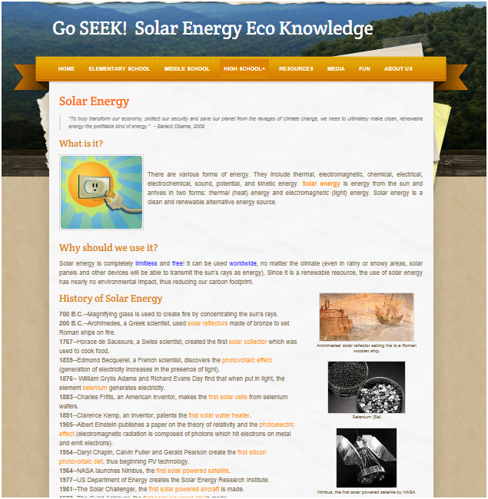
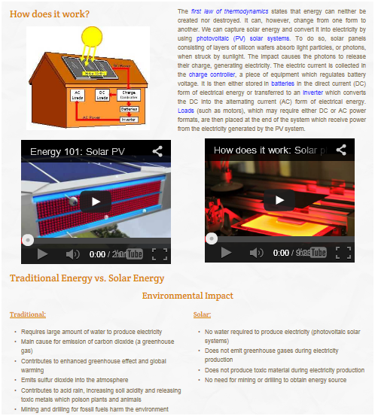
Go SEEK!
Solar Energy Eco Knowledge

Slide 24
Thank you for learning with us!

